Slide 1
Basics of C# Programming
Day 1

Slide 2
1. C# Language and .NET Platform
C# is designed as an object-oriented programming and a strongly typed language developed by Microsoft. It is widely used for developing Windows applications, web applications, and more. C# is a key language in the .NET ecosystem, offering features like garbage collection and a unified type system.

Slide 3
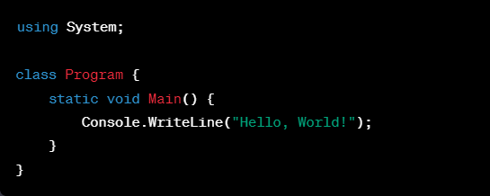
2. First C# Program
Explanation: Writing a simple "Hello World" program in C# to understand the basic structure.
Code Example:

Slide 4
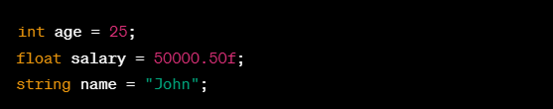
3. Data Types
Explanation: Overview of different data types in C# (int, float, double, string, etc.).
Code Example:

Slide 5
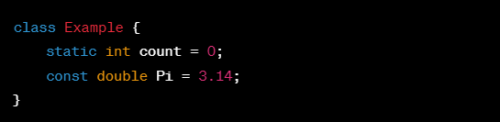
4. Static Variables and Constants
Explanation: Introduction to static variables and constants.
Code Example:

Slide 6
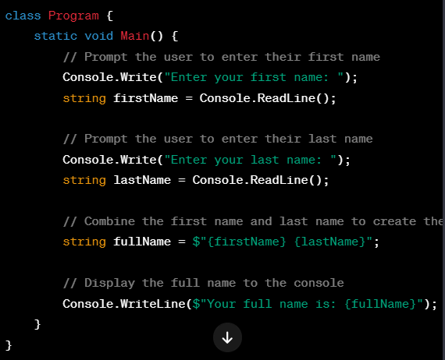
5. Console Output
Explanation: Using the Console class for basic output operations.
Code Example:

Slide 7

6. Arithmetic and Comparison Operations
Explanation: Basic arithmetic and comparison operators in C#.
Code Example:

Slide 8
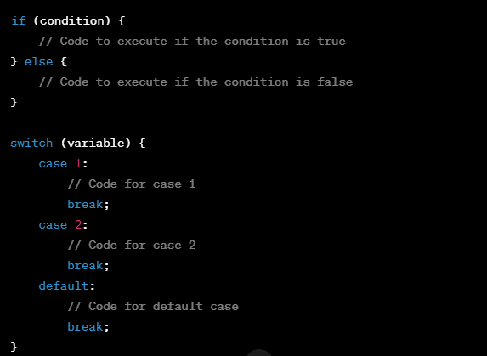
7. If..Else and Switch Case
Explanation: Control flow structures for decision-making.
Code Example:

Slide 9
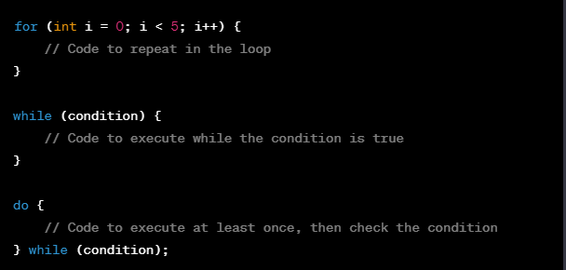
8. Loops
Explanation: Introduction to different types of loops (for, while, do-while).
Code Example:

Slide 10

8. Arrays
Explanation: Basics of arrays and their usage.
Code Example:

